Slide 1
vision – virtual assistant Introduction
VISION, as name describe it interpret your voice command into action with n number of things you
can think of.
Vision is made of Python Programming Language with ability to perform various task such as sending mail, asking time, opening any software, listening music, reading any document, etc. these task are
performed by the system only by your voice command.
These tasks are not limited, you can even add more custom task by just adding few lines of code in it.
I have almost perform all the general task in it.
As in beginning I have told it is made of Python so various library are used in it to perform these tasks
successfully.

Slide 2
Hardware and software
HARDWARE:
CPU - INTEL i7-9750H
RAM - 8 GB
GRAPHICS – NVIDIA GEFORCE GTX 1650 (4 GB)
SOFTWARE:
PYCHARM EDU

Slide 3
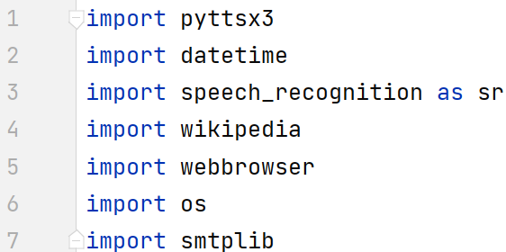
STRUCTURE
LIBRARY USED IN VISION.PY
PYTTSX3 : Is a text-to-speech conversion library in Python, we are using it as it works offline.
DATETIME : It is used to know the current Date and Time.
SPEECH_RECOGINITON : It is used to recognize voice command and convert into text
WIKIPEDIA : It is used to answer some meaning questions.
WEBBROWSER : It is used to open particular link using using specific browser.
OS : It helps in interaction with operation system.
SMTPLIB : it is used to send emails.
I have build vision.py using -

Slide 4
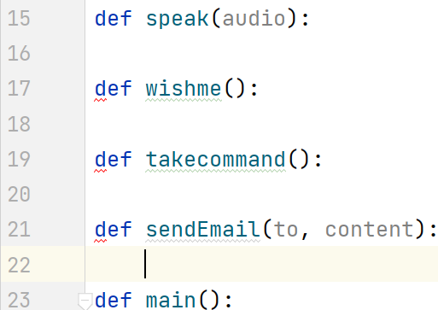
STRUCTURE
FUNCTIONS USED IN VISION.PY
Speak() : convert the text into audio by using PYTTSX3.
Wishme() : wish me according to morning, afternoon and night by the help of DATETIME.
TakeCommand() : it uses recognizer of SPEECH_RECOGNITiON to convert my audio into text and then
return The command
SendEmail() : helps in sending the mail with the help of SMTPLIB.
Main() : it is the brain of the vison.py as it holds almost every command that anyone can ask for and let
required function to be call and work to fulfil that task.
FUNCTIONS USED IN VISION.PY
Speak() : convert the text into audio by using PYTTSX3.
Wishme() : wish me according to morning, afternoon and night by the help of DATETIME.
TakeCommand() : it uses recognizer of SPEECH_RECOGNITION to convert my audio into text and then
return The command
SendEmail() : helps in sending the mail with the help of SMTPLIB.
Main() : it is the brain of the vison.py as it holds almost every command that anyone can ask for and let
required function to be call and work to fulfil that task.

Slide 5
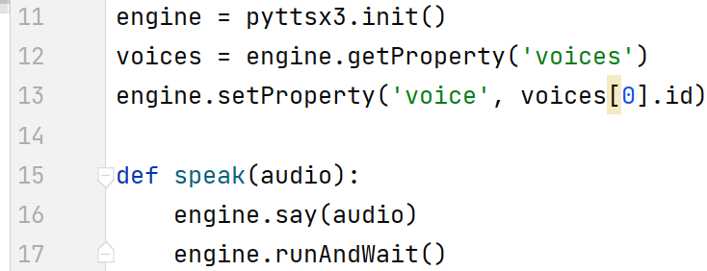
explanation
SPEAK() FUNCTION USED IN VISION.PY
IN LINE 11- I HAVE INITILIZED OBJECT
IN LINE 12 – SETTING PROPERTY
IN LINE 13 – I AM SETTING THE TYPE OF
VOICE. 0 FOR MALE AND 1 FOR FEMALE
IN LINE 15 – DEFINED FUNCTION SPEAK HAVING ARGUMENT NAMED AS AUDIO. AUDIO IS
TEXT FORMAT PASSING TO THIS FUNCTION TO SPEAK.
IN LINE 16-17- I USED SAY() TO LET THE TEXT BE SPOKEN BY THE SYSTEM AND THEN TERMINATE.

Slide 6
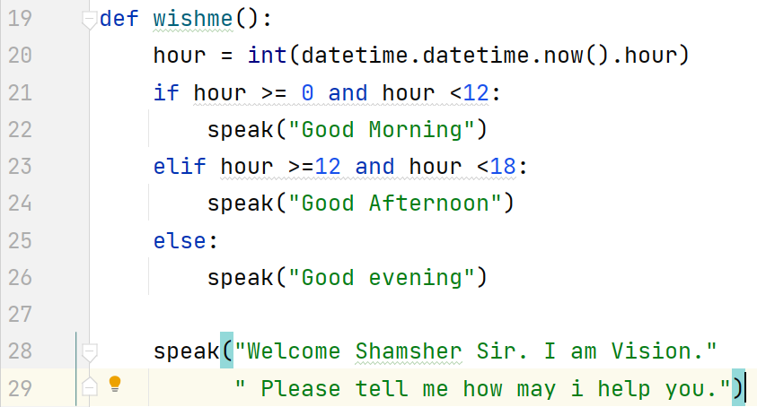
explanation
WISHME() FUNCTION USED IN VISION.PY
IN LINE 19 - WE HAVE DEFINE WISHME FUNCTION THAT
WILL WISH ME ACCORDING TO THE CURRENT TIME AND
WELCOME ME.
IN LINE 20 – GETTING THE CURRENT TIME AND STORING IT
IN ’HOUR’.
IN LINE 21-26 – CHECKING FOR MORNING, AFTERNOON
OR NIGHT AND THEN PASSING TO THE SPEAK FUNCTION.
IN LINE 28-29 – PASSING WELCOME MESSAGE TO SPEAK FUNCTION.

Slide 7
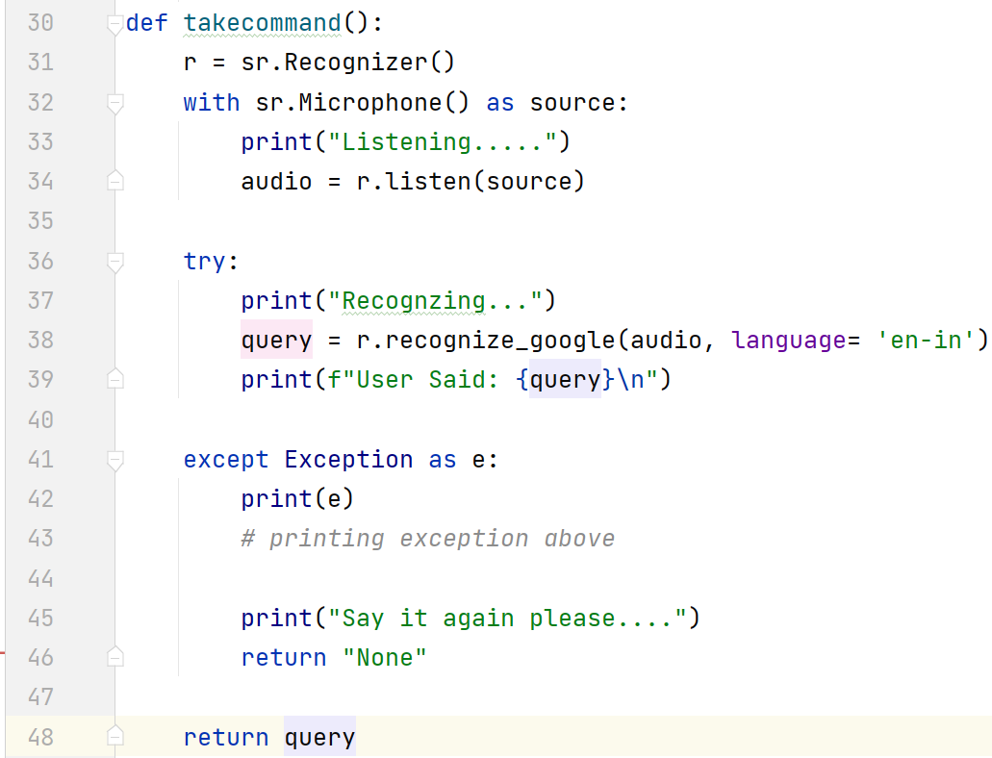
explanation
TAKECOMMAND() FUNCTION USED IN VISION.PY
IN LINE 30 – DEFINED TAKECOMMAND FUNCTION THAT WILL
LISTEN TO THE USER COMMAND AND RETURN IT.
IN LINE 31 – WE HAVE INITILIZED RECOGNIZER
IN LINE 32-34 – INITILIZING MICROPHONE AS A SOURCE AND
STROING MY COMMAND IN AUDIO VARIABLE.
WE HAVE ENCLOSE OUR RECOGNIZER IN TRY AND EXCEPT BLOCK
TO OVERCOME TERMINATION OF PROGRAM DUE TO ERROR.
IN LINE 39 – RECOGNIZING MY AUDIO USING RECOGNIZE_GOOGLE WHILE ASURING ENGLISH AS MY LANGUAGE.
IF EXCEPTION OCCUR IT WILL PRINT THE EXCEPTION AND ASK USER TO SPEAK AGAIN IN LINE 45 AND RETURNING NONE.
IN LINE 48- AT LAST WHILE VOICE COMMAND IS ACCEPTED AND RETURN IN THE FORM OF TEXT.

Slide 8
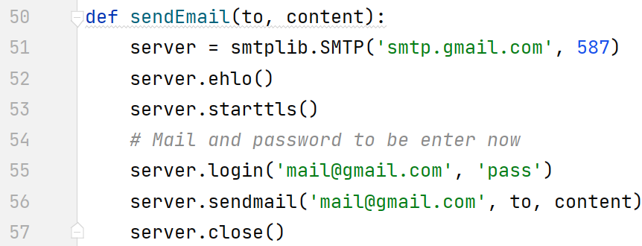
explanation
SENDEMAIL() FUNCTION USED IN VISION.PY
IN LINE 50 – WE HAVE DEFINE SENDEMAIL FUNCTION IN
WHICH TO AND CONTENT ARE BEIGN PASSED.
IN LINE 51 – SETTING UP THE SERVER ALONG WITH THE
PORT NUMBER
IN LINE 55 - LOGGING IN INTO THE MAIL ID FROM WHERE I HAVE TO SEND THE EMAILS USING LOGIN
FUNCTION WHILE HAVING EMAIL ID AS FIRST ARGUMENT AND PASSWORD AS SECOND ARGUMENT.
IN LINE 56 – SENDING EMAIL BY SENDMAIL FUNCTION AS HAVING MY EMAIL ID FIRST, ALONG WITH
THE RECIEVER ID SAVED IN TO AND THE EMAIL DATA IN CONTENT.
*IF YOU WANT TO HIDE PASSWORD OF YOUR MAIL YOU CAN SAVE IT INTO A TEXT FILE AND
THEN USE IT BY THE HELP OF FILE HANDLING. THAT WILL NOW VISIBLE YOUR PASSWORD.

Slide 9
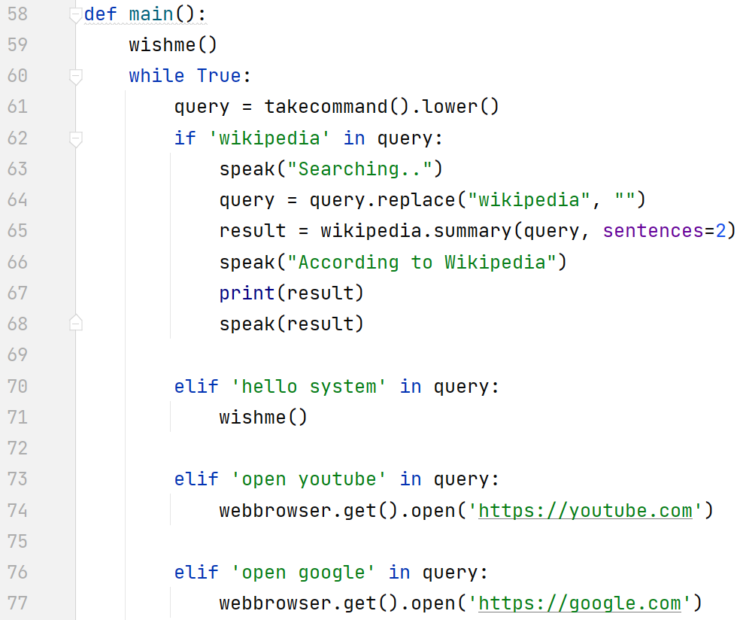
explanation
MAIN() FUNCTION USED IN VISION.PY
IN LINE 58 – DEFINED MAIN FUNCTION, THIS WILL HANDLE ALL THE FUNCTIONS.
IN LINE 59 – CALLED WISHME FUNC. SO WHILE RUNNING IT FIRST WISH ME.
IN LINE 60 - WE USE TO ENCLOSE EACH STATEMENT IN WHILE LOOP AND DEFINED IT AS TRUE.
IN LINE 61 – CALLING THE TAKECOMMAND FUNCTION TO TAKE
COMMAND FROM THE USER AND RETURN IT INTO QUERY VARIABLE
IN LINE 62-68 – IF THE WIKIPEDIA WORD IS IN THE COMMAND SO IT WILL SEARCH THE REST OF THE QUESTION
BY USING SUMMARY() AND THEN PASS THE RESULT TO SPEAK FUNCTION.
IN LINE 70 – IF WE SAY ’HELLO SYSTEM’ IT WILL WISH ME BY CALLING WISHME FUNCTION
IN LINE 73-77 – IF I ASK HIM TO OPEN YOUTUBE OR GOOLE IT WILL OPEN IT USING WEBBROWSER.GET().OPEN()

Slide 10
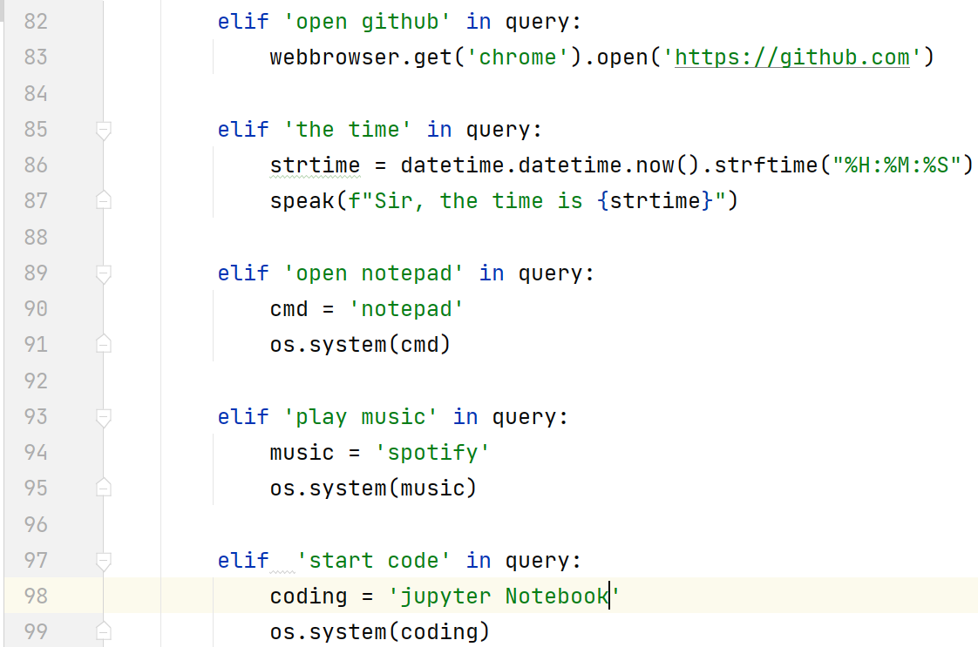
explanation
MAIN() FUNCTION USED IN VISION.PY (contd.)
IN LINE 82 – WE HAVE ARE OPENING GITHUB ON COMMAND
‘OPEN GITHUB’
IN LINE 85-87 – ASKING FOR THE TIME IT WILL LET ME KNOW
THE CURRENT TIME BY DATETIME MODULE.
IN LINE 89- ‘OPEN NOTEPAD’ COMMAND WILL OPEN MY
NOTEPAD FROM THE SYSTEM WITH HELP OF OS.SYSTEM()
IN LINE 93 - ’PLAY MUSIC’ COMMAND WILL OPEN MY SPOTIFY APP BY OS.SYSTEM() INCLUDING APP NAME IN
THE DIRECTORY IN THE ARGUMENT.
IN LINE 97 - ‘START CODE’ COMMAND WILL OEPN MY ANACONDA EDITOR.

Slide 11
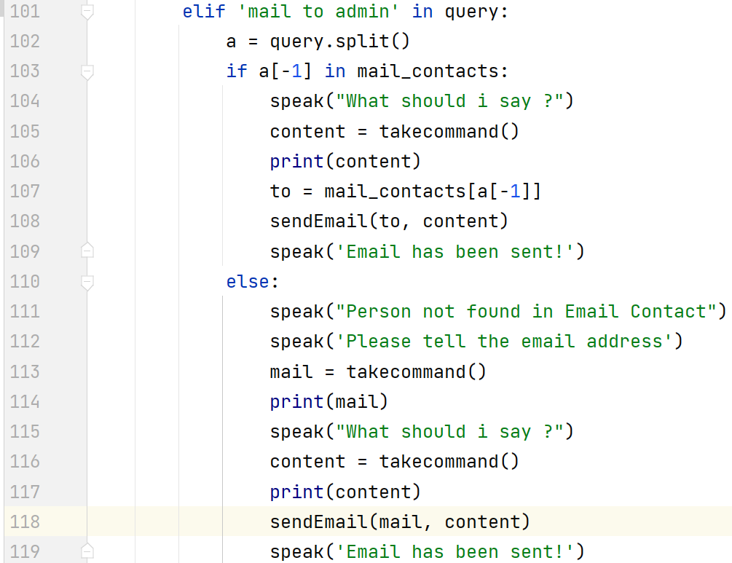
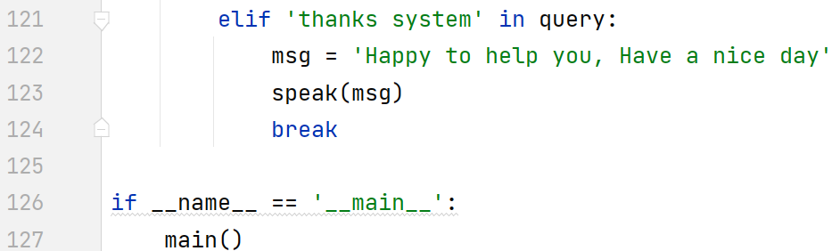
explanation
MAIN() FUNCTION USED IN VISION.PY (contd.)
FROM LINE 101 TO 119– MAIL COMMAND WILL MAIL TO THE
RESECTIVE PERSON BY TAKING THE CONTENT FROM VOICE
AND MAIL TO THE PERSON BY USING SAVED ADDRESS IN
MAIL_CONTACT DICTIONARY.
IF PERSON IS NOT FOUND IT WILL ASK FOR THE MAIL ADDRESS
ALONG WITH THE CONTENT.
AND FINALLY SENDING THE CONTENT AND PERSON MAIL ADDRESS
TO SENDEMAIL() FUNCTION TO SEND MAIL.
IN LINE 121-124 – MAIN WILL RUN INFINTE TIME UNTIL IT IS STOP
SO WE HAVE SET UP A COMMAND ‘THANKS SYSTEM’ TO STOP THE
ITERATION BY USING BREAK.
AT LAST LINE 126-127 - MAIN IS CALLED.

Slide 12


